Slide 1
1. General information about course
Title of the course :
Finite element analysis of reinforced concrete structures
Professor: dr. Senad Medić
Institution: University of Sarajevo
E-mail: senad_medic@yahoo.com, senad.medic@gf.unsa.ba

Slide 2
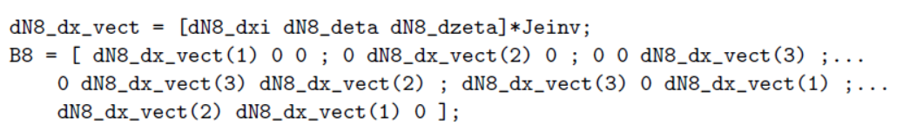
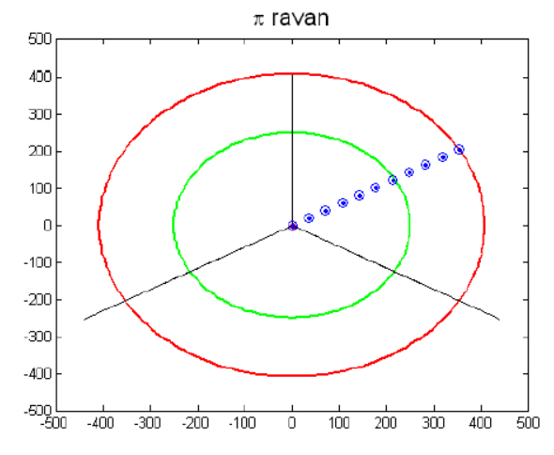
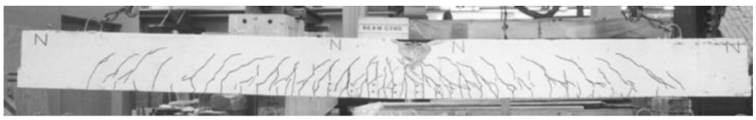
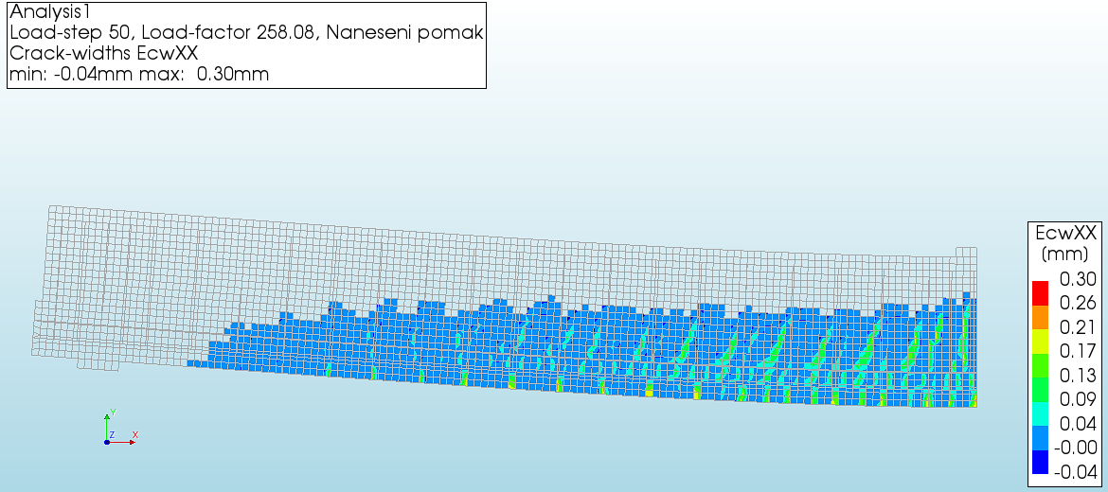
2. Description of the course
Content:
Computational mechanics and real-life structures.
Structure of the course:
Introduction to finite element method.
Analysis of RC structures: beams, frames, walls, slabs, discontinuities, foundations.
Experimental testing and computational modeling:
shear failure of beams and slabs under concentrated forces,
slender RC walls and beams exposed to cyclic loading,
behavior of concrete structures under elevated temperatures.

Slide 3
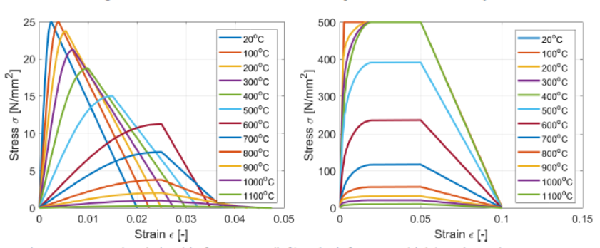
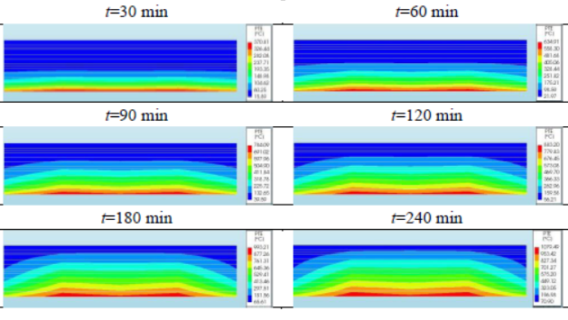
3. Target group and prerequisites
Target group/Learners profile
Students: Master & PhD
Structural engineers from industry with interest in modeling of structures
Prerequisites (required pre-knowledge and experiences)
Basic knowledge of theory of structures
Fundamentals of programming (any language)
Elementary experience with finite element programs (any kind)

Slide 4
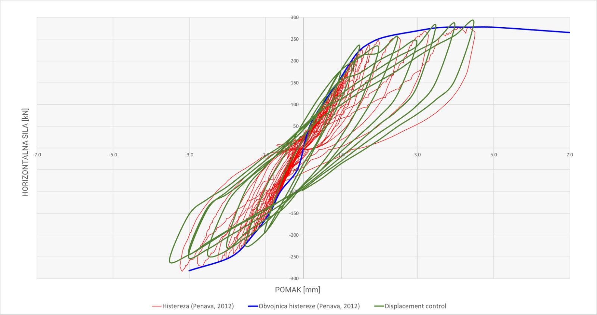
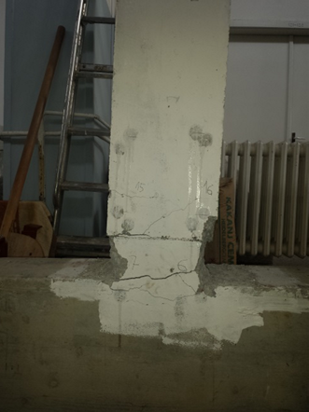
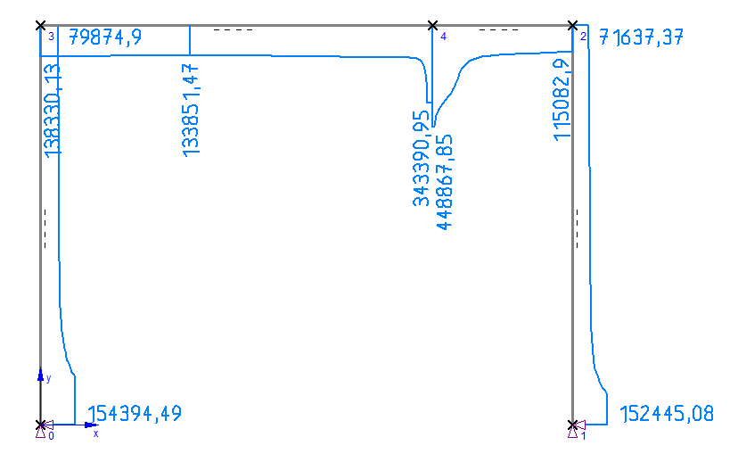
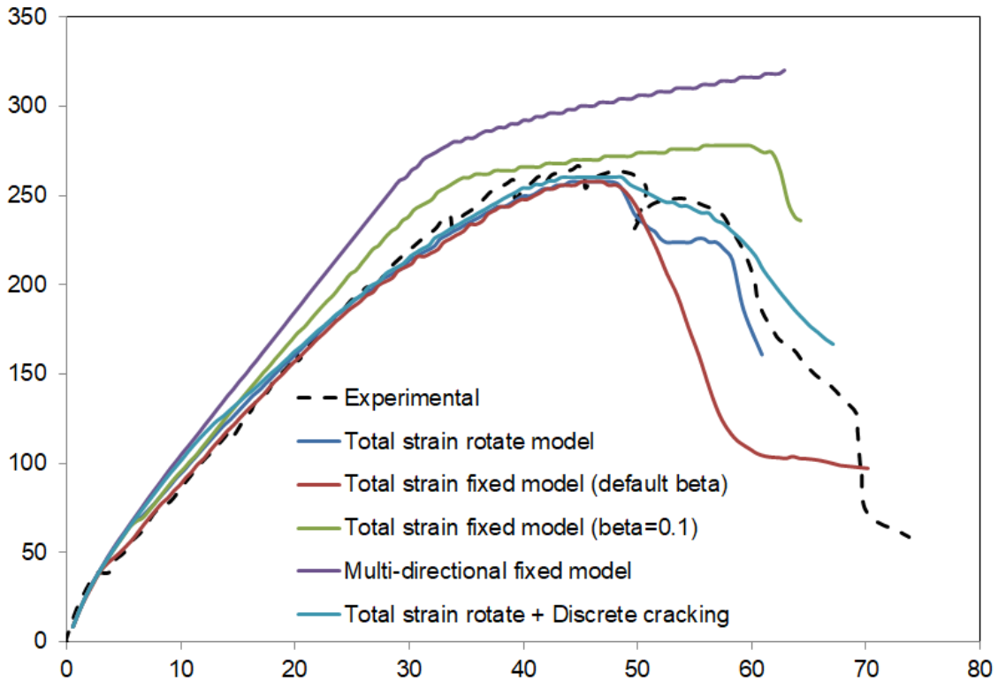
4. Learning outcomes
Mastering numerical modeling of engineering structures using commercial solvers.
Bridging the gap - theoretical knowledge, experimental (DIC) and numerical modeling
Introduction to advanced modeling for research purposes.

Slide 5
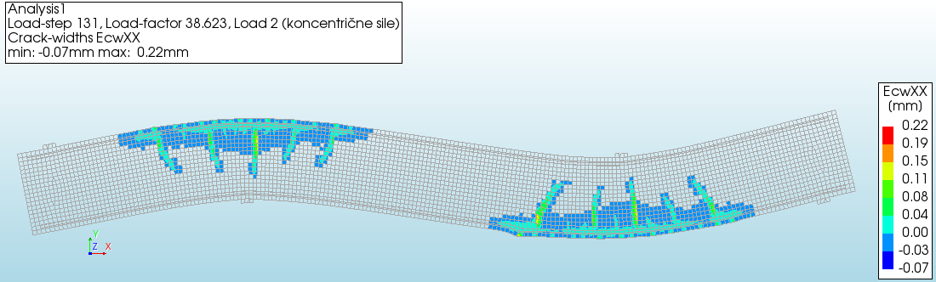
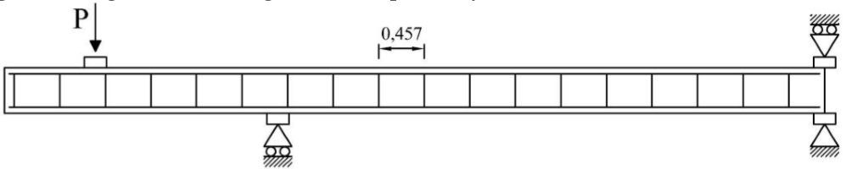
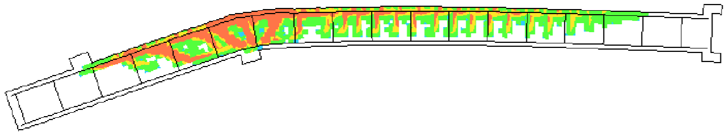
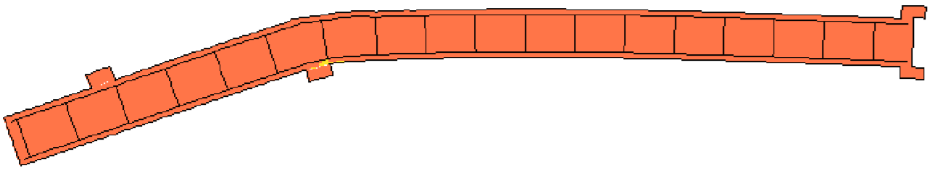
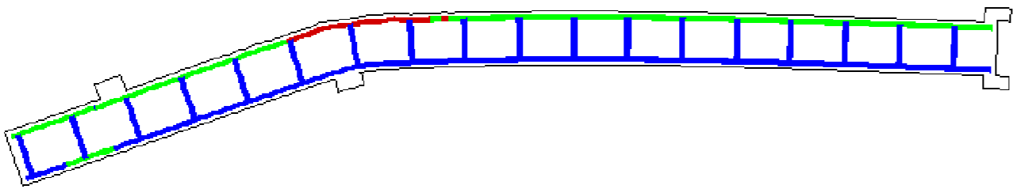
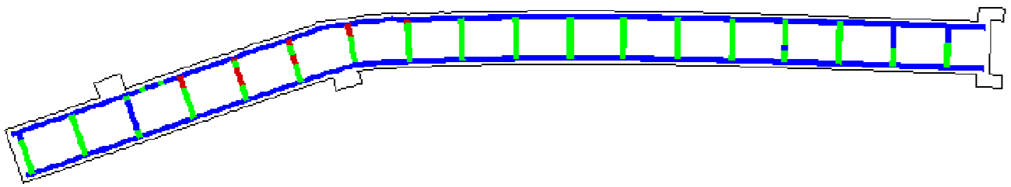
5. Training and learning methods
Condensed online lectures.
Supported self-study and group training.
Recommended reading & project assignements.

