Slide 1
1. General information about course
Title of the course :
Finite element analysis of reinforced concrete and masonry structures
Professor: dr. Senad Medić/dr. Sergey Churilov
Institution: University of Sarajevo/Ss. Cyril and Methodius University
E-mail: senad.medic@gf.unsa.ba, curilov@gf.ukim.edu.mk

Slide 2
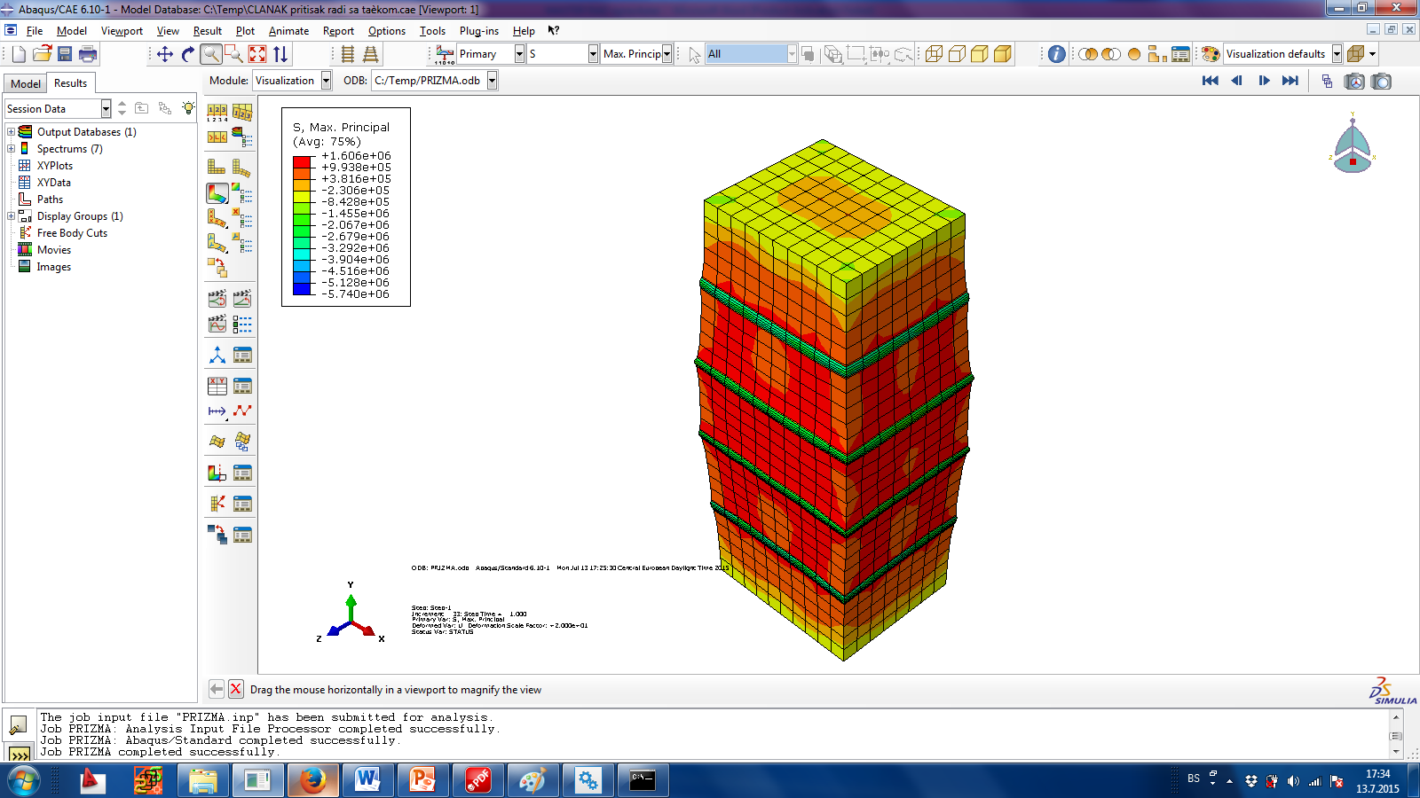
2. Description of the course
Content:
Computational mechanics and real-life structures.
Structure of the course:
Introduction to finite element method.
Experimental testing and computational modeling of masonry: wallets, in-plane response of solid brick masonry walls, strengthening of masonry, framed masonry for reversed horizontal loads, influence of wall openings.
Macro-models
Meso-models

Slide 3
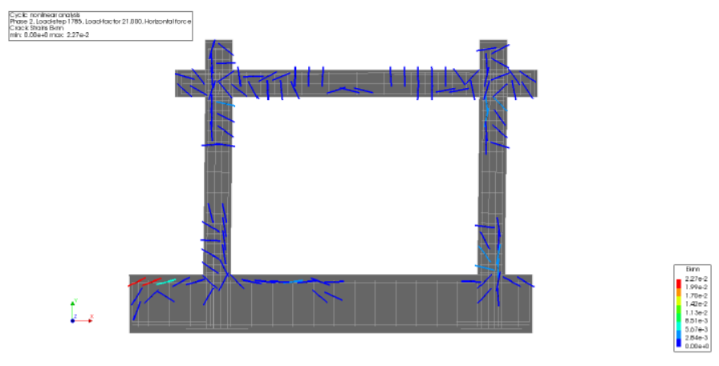
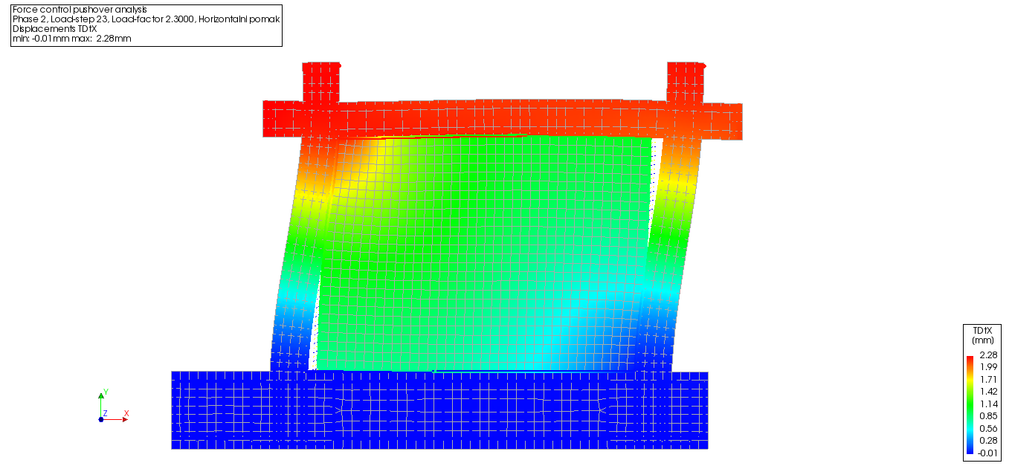
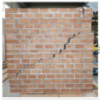
3. Target group and prerequisites
Target group/Learners profile
Students: Master & PhD
Structural engineers from industry with interest in modeling of structures
Prerequisites (required pre-knowledge and experiences)
Basic knowledge of theory of structures
Elementary experience with finite element programs (any kind)

Slide 4
4. Learning outcomes
Mastering numerical modeling of engineering structures using commercial solvers.
Bridging the gap - theoretical knowledge, experimental (DIC) and numerical modeling
Introduction to advanced modeling for research purposes.

Slide 5
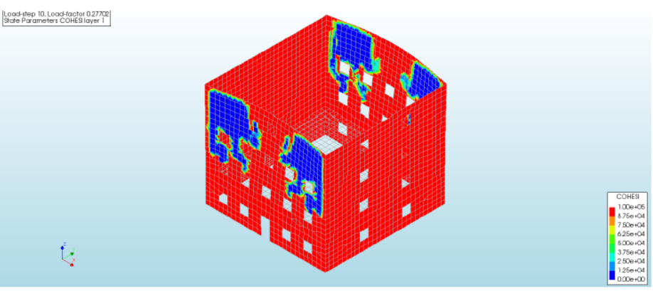
5. Training and learning methods
Condensed online lectures.
Supported self-study and group training.
Recommended reading & project assignements.

