Slide 1
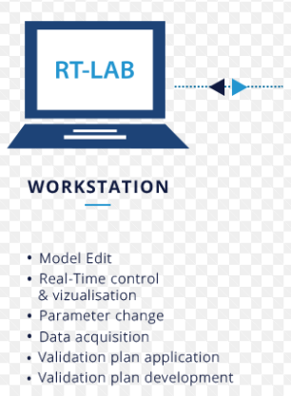
1. General information about the Innovative teaching practice
Title: Real –time remote laboratory
>> Remote experimental work
Professor: Simona Bogoevska
Institution: University of Ss. Cyril and Methodius Skopje
Mail: simona.bogoevska@gf.ukim.edu.mk

Slide 2
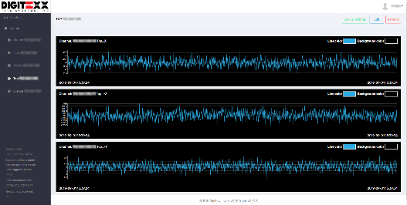
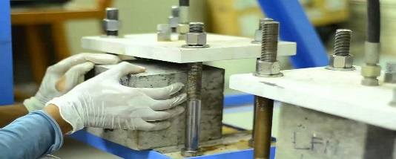
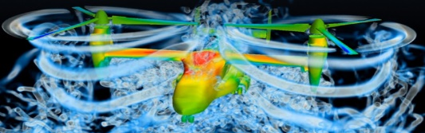
2. Description of the innovative teaching practice
Each participant in the course will select an available lab experiment from a provided list of web platforms.
The list of offered remote laboratories is predefined with involved companies .
A specific case study will be appointed , and it will include conducting laboratory experiment.
Depending on the covered curriculum, the laboratory web platform can be organised either as:
real-time autonomous laboratory
real-time remote (one-on-one) communication with lab staff
real-time simulation-based “experiments” for software developers
Results and data will be directly applied and included in the appointed case study.
Companies will be directly involved via the laboratory web platforms
select your laboratory
Tower monitoring lab
Concrete
testing lab
Simulation testing

Slide 3
3. Duration and Target group
Duration
4 weeks
Target group
Students
Professionals
Involvement of industry or third parties
YES

Slide 4
4. Skills to be acquired/ improved:
Soft skills – People related skills: direct impact on Communication and Interpersonal skills (e.g. via discussions and planning lab work with appointed company staff)
Hard skills – Conceptual/thinking skills: direct impact on Analytic thinking (e.g. enhance learning by evaluating experimental data, gained with involvement in all stages of planning and obtaining ) indirect impact on Presentation skills (e.g. presenting full case study at the finalization of the course)
Business skills: direct impact on Creativity/innovation (e.g. creating appropriate lab program) indirect impact on developing sense for managing and team work (e.g. apply management for lab staff coordination and team work)

Slide 5
5. Methods and techniques
Format > Case study and remote involvement
Techniques completed with individual work: problem solving and planning strategies
Techniques completed in teams: debate and demonstration with company support system,
Available resources via e-learning platform: articles, presentations, forum

Slide 6
6. Methods for assessment and evaluation of the practice
Methods for assessment
Final presentation of the case study with:
evaluation received from an appointed company representative
evaluation received from the course teacher
Methods for evaluation
Evaluation lists and feedback from students

