Slide 1
1. General information about the course
Title of the course Academic Teachers Institution E-Mail | Environmental Wind Engineering Prof. Dr.-Ing. Rüdiger Höffer Dr.-Ing. Cornelia Kalender Simon Tewolde, M.Sc. Simon Kosse, M.Sc. Ruhr University Bochum Faculty of Civil and Environmental Engineering Research Group for Wind Engineering and Fluid Dynamics simon.kosse@rub.de

Slide 2
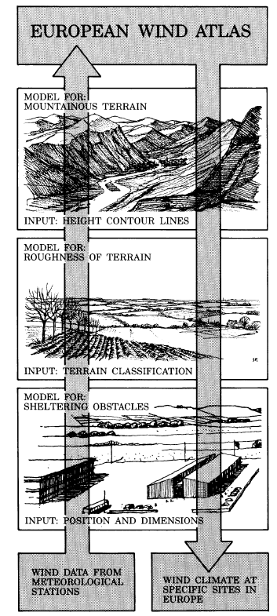
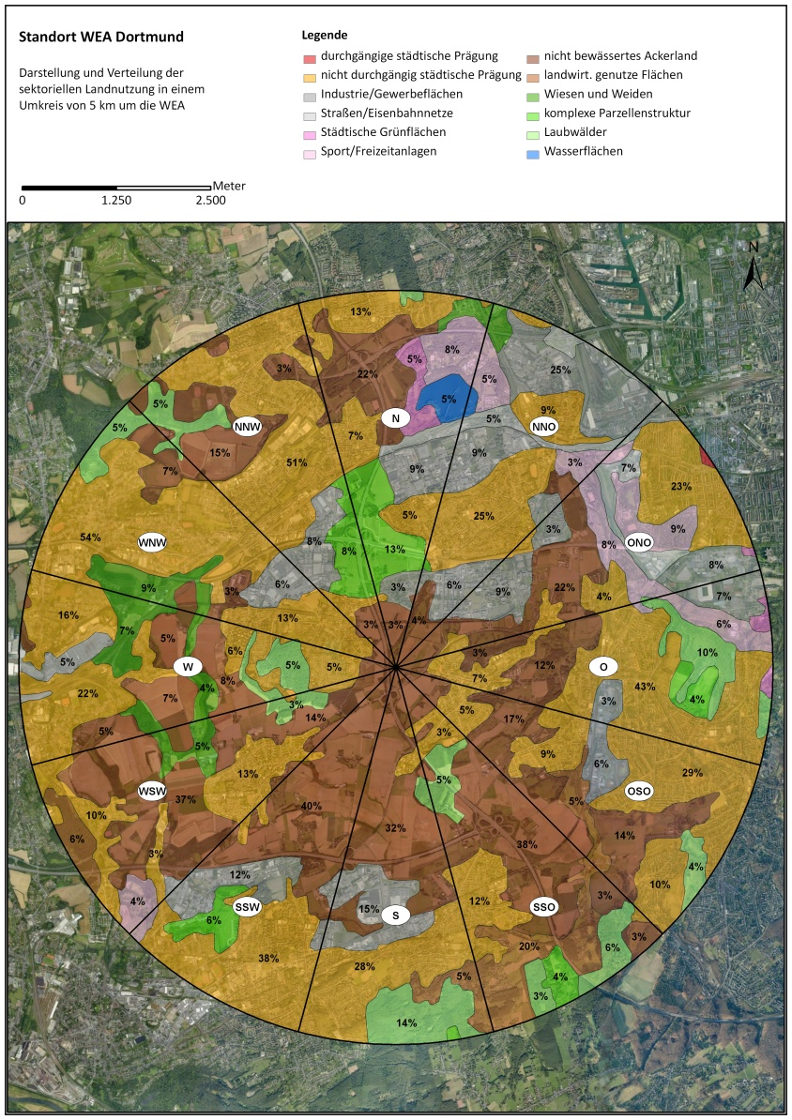
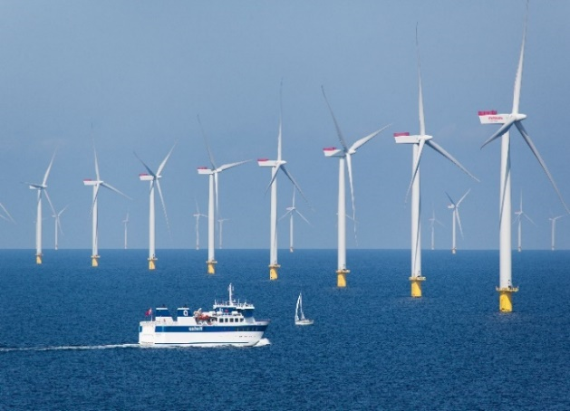
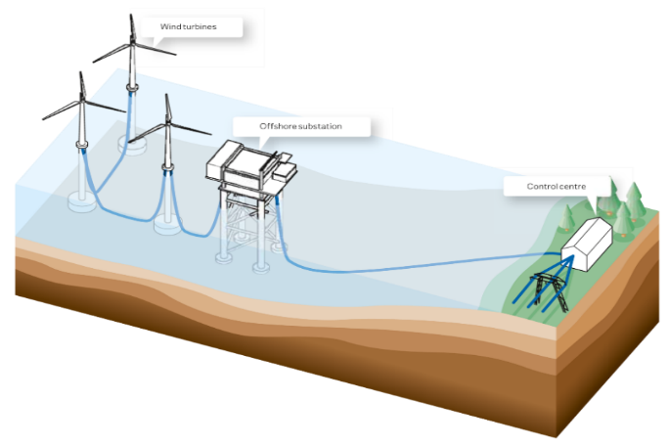
2. Description of the course
Part 1 – Air Quality:
Air pollutants, their impact chain in the environment and legal basis in the EU
Mathematical description of wind and the transport processes in air and their implementation in different dispersion models
Model choice, quality assurance, validation and evaluation of model results
Example of practical application of dispersion models
Part 2 – Wind Energy:
Wind as a resource
Analysis of wind ensembles by Weibull distributions
Turbine efficiencies and power yield calculation
Design and verification of main components
Modelling of wind farms (Onshore & Offshore)

Slide 3
3. Target group and prerequisites
Target group/Learners profile
The course aims at interested learners, also professionals active in public and technology sectors, who have knowledge in the field of descriptive statistics and mechanics including fluid mechanics as well as educated knowledge in the field of engineering.
Prerequisites (required pre-knowledge and experiences)
It is recommended that the interested learner carries a Bachelor's degree in engineering or equivalent.

Slide 4
4. Learning outcomes
The participants will be able:
to identify and assess wind related effects on air quality in the built environment;
to choose suitable strategies for the optimization of wind energy harvesting and for controlling impacts on the structures
The participant will recapitulate information about
the validation the quality of engineering models using measurement data from model and real experiments,
and classify criteria
to properly assess engineering decisions based on the nature of the wind effects under consideration and the quality of the engineering model and the suitability of the approach.
The participants will be able to work in an international group in order to train their management, presentation and language skills.

Slide 5
5. Training and learning methods
Podcasts and exercise-based self-learning (ca. 50h in total)
Synchronous digital teaching following the inverted classroom method (ca. 10h in total)
The above program is valid for the release of two credits (2 ECTS)
Mandatory for the allocation of one additional credit (1 ECTS) is the participation to a tailored Virtual Exchange program in international learner’s groups of ca. 20h-30h

Slide 6
Virtual Exchange
„Virtual exchanges are technology-enabled, sustained, people-to-people education programs.“ (http://virtualexchangecoalition.org)
The teachers and their support teams work together to develop:
shared learning outcomes
a syllabus for this new international component
With a focus on the development of activities that promote:
interaction during synchronous sessions
collaboration between students
The implementation of this activity to the All4R&D course program will
be generally digital,
covers approx. 30h in 4-6 weeks,
includes synchronous sessions,
builds on mixed (international) learner‘s groups who deliver input after their own viewpoint of technical culture to the group work,
be mandatory for the allocation of credits (3 ECTS).

