Slide 1
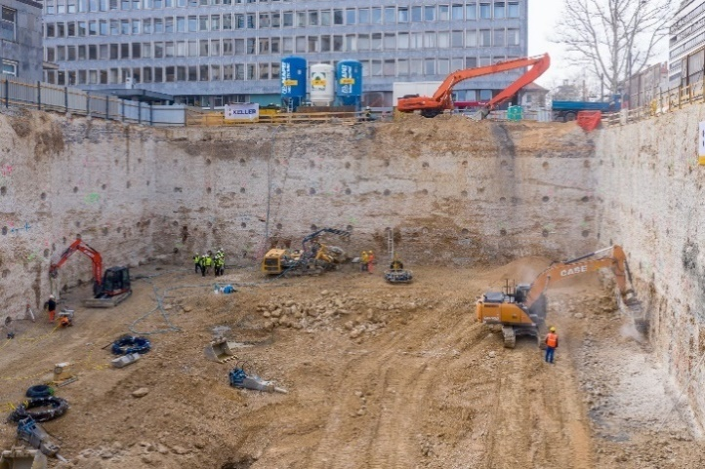
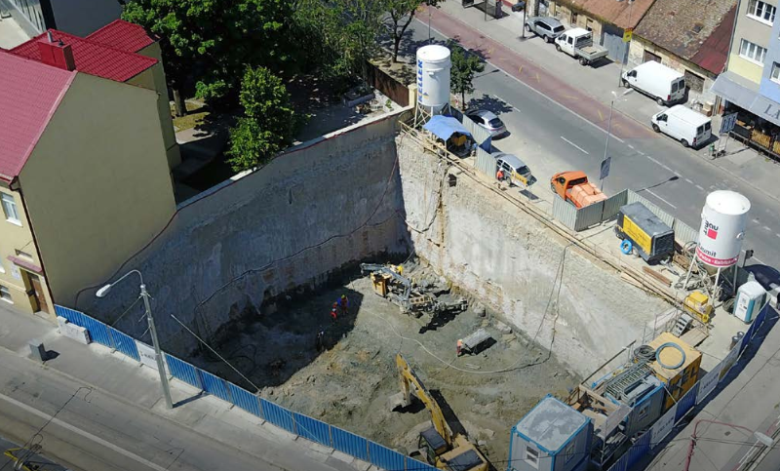
1. General information about course
Title of the course: Geotechnical Engineering in Urban Environment
DI Zlatko Dzanic
Institution: Keller Grundbau GmbH, Vienna, Austria
E-mail: dzanic_z@yahoo.com

Slide 2
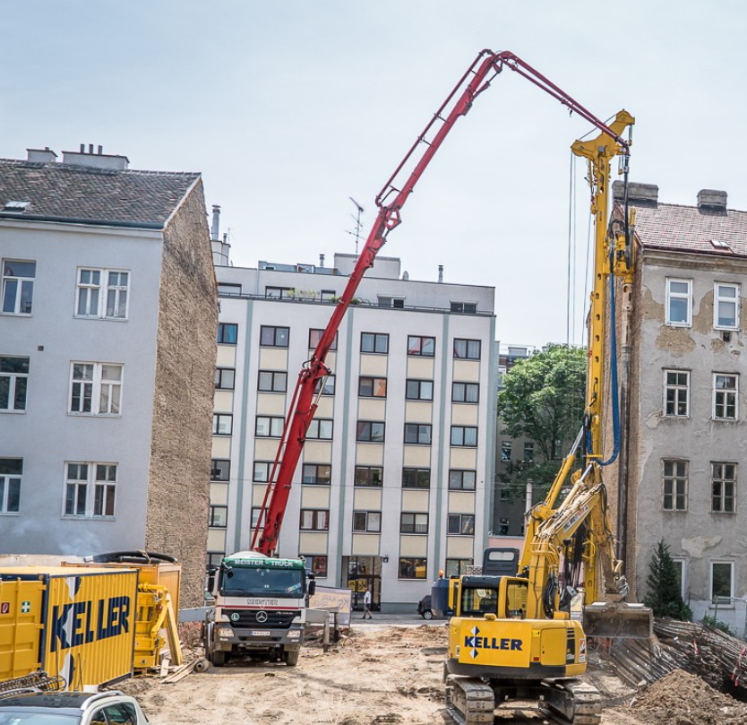
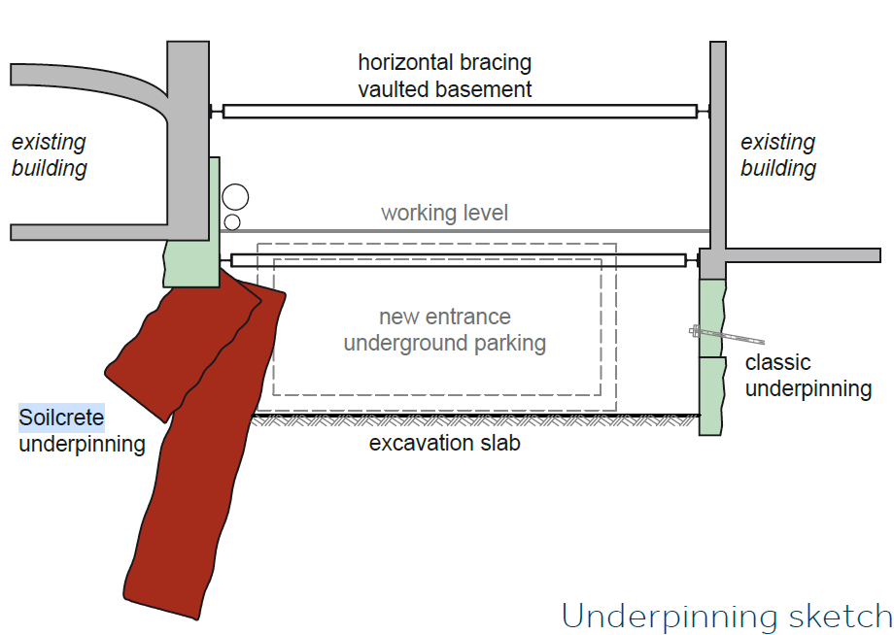
2. Description of the course
Introduction to geotechnical engineering in urban environment with real-life examples.
Design of standard pile wall supporting systems and innovations in implementation of jet grouting solutions.
Standard calculation methods and numerical modeling utilizing Plaxis.
Calculation of wall horizontal deflections, vertical settlements and overall system stability.
Design of various anchoring systems, technical aspects of groundwater management.

Slide 3
3. Target group and prerequisites
Target group/Learners profile
Engineers from praxis,
Students: Bachelor, Master, PhD
Designers, geotechnical or site engineers with interest in solving of urban excavation problems
Prerequisites (required pre-knowledge and experiences)
Basics of soil mechanics and geotechnical structural design
Elementary knowledge in design/construction of excavation pits

Slide 4
4. Learning outcomes
Learning the engineering techniques required for successful design of excavation pits in an urban environment.
Introduction to advanced modeling for research purposes.
Lessons learned from real projects.
Understanding challenges and need for innovations.

Slide 5
5. Training and learning methods
Online lectures and discussions.
Individual research with examples.
Case studies .

