Slide 1
1. General information about course
Title of the course: Landslides in highway construction
Assistant professor Adis Skejić
Institution: University of Sarajevo, Faculty of Civil Engineering
E-mail: askeja@live.com

Slide 2
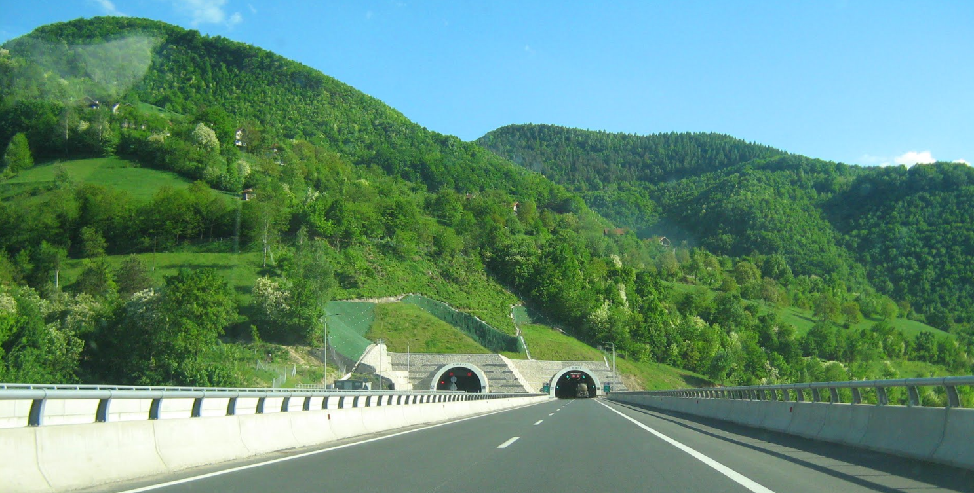
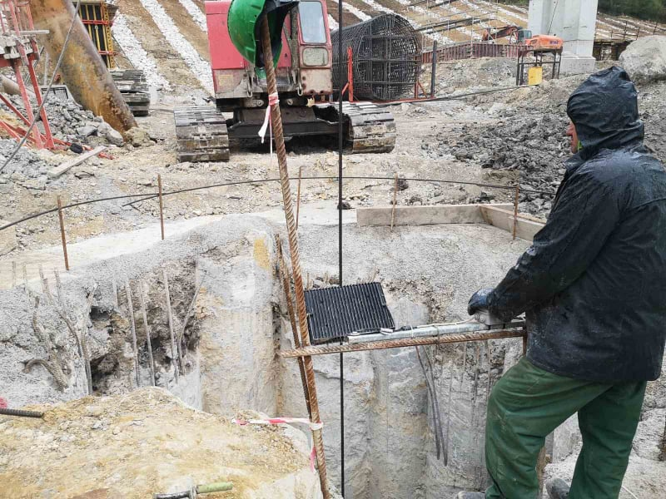
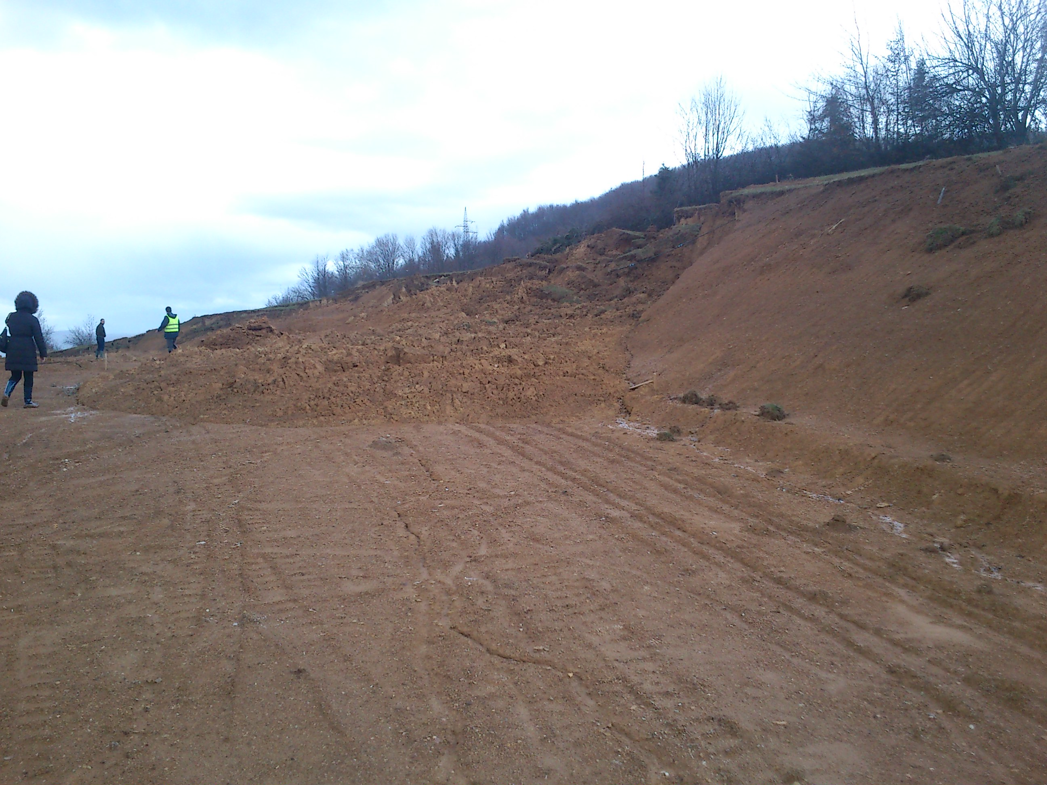
2. Description of the course
Introduction. Landslides and nature in Bosnia and Herzegovina. Challenges of highway construction in landslide areas
Investigation works, monitoring plan, and observational methods.
Retaining walls and drainages as landslide remediation measures, foundations of viaducts in landslides.
Computer software for identification of failure mechanism and design of remediation measures.
Case studies including examples of slope failures during construction.

Slide 3
3. Target group and prerequisites
Target group/Learners profile
Engineers from praxis,
Master students different fields of civil/geotechnical engineering,
Designers, geotechnical or other civil engineers having interest in landslide related problems during highway construction
Prerequisites (required pre-knowledge and experiences)
Principal soil mechanics,
Knowledge and experience in design/construction of geotechnical structures

Slide 4
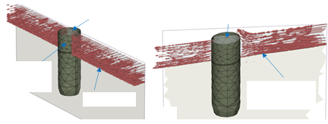
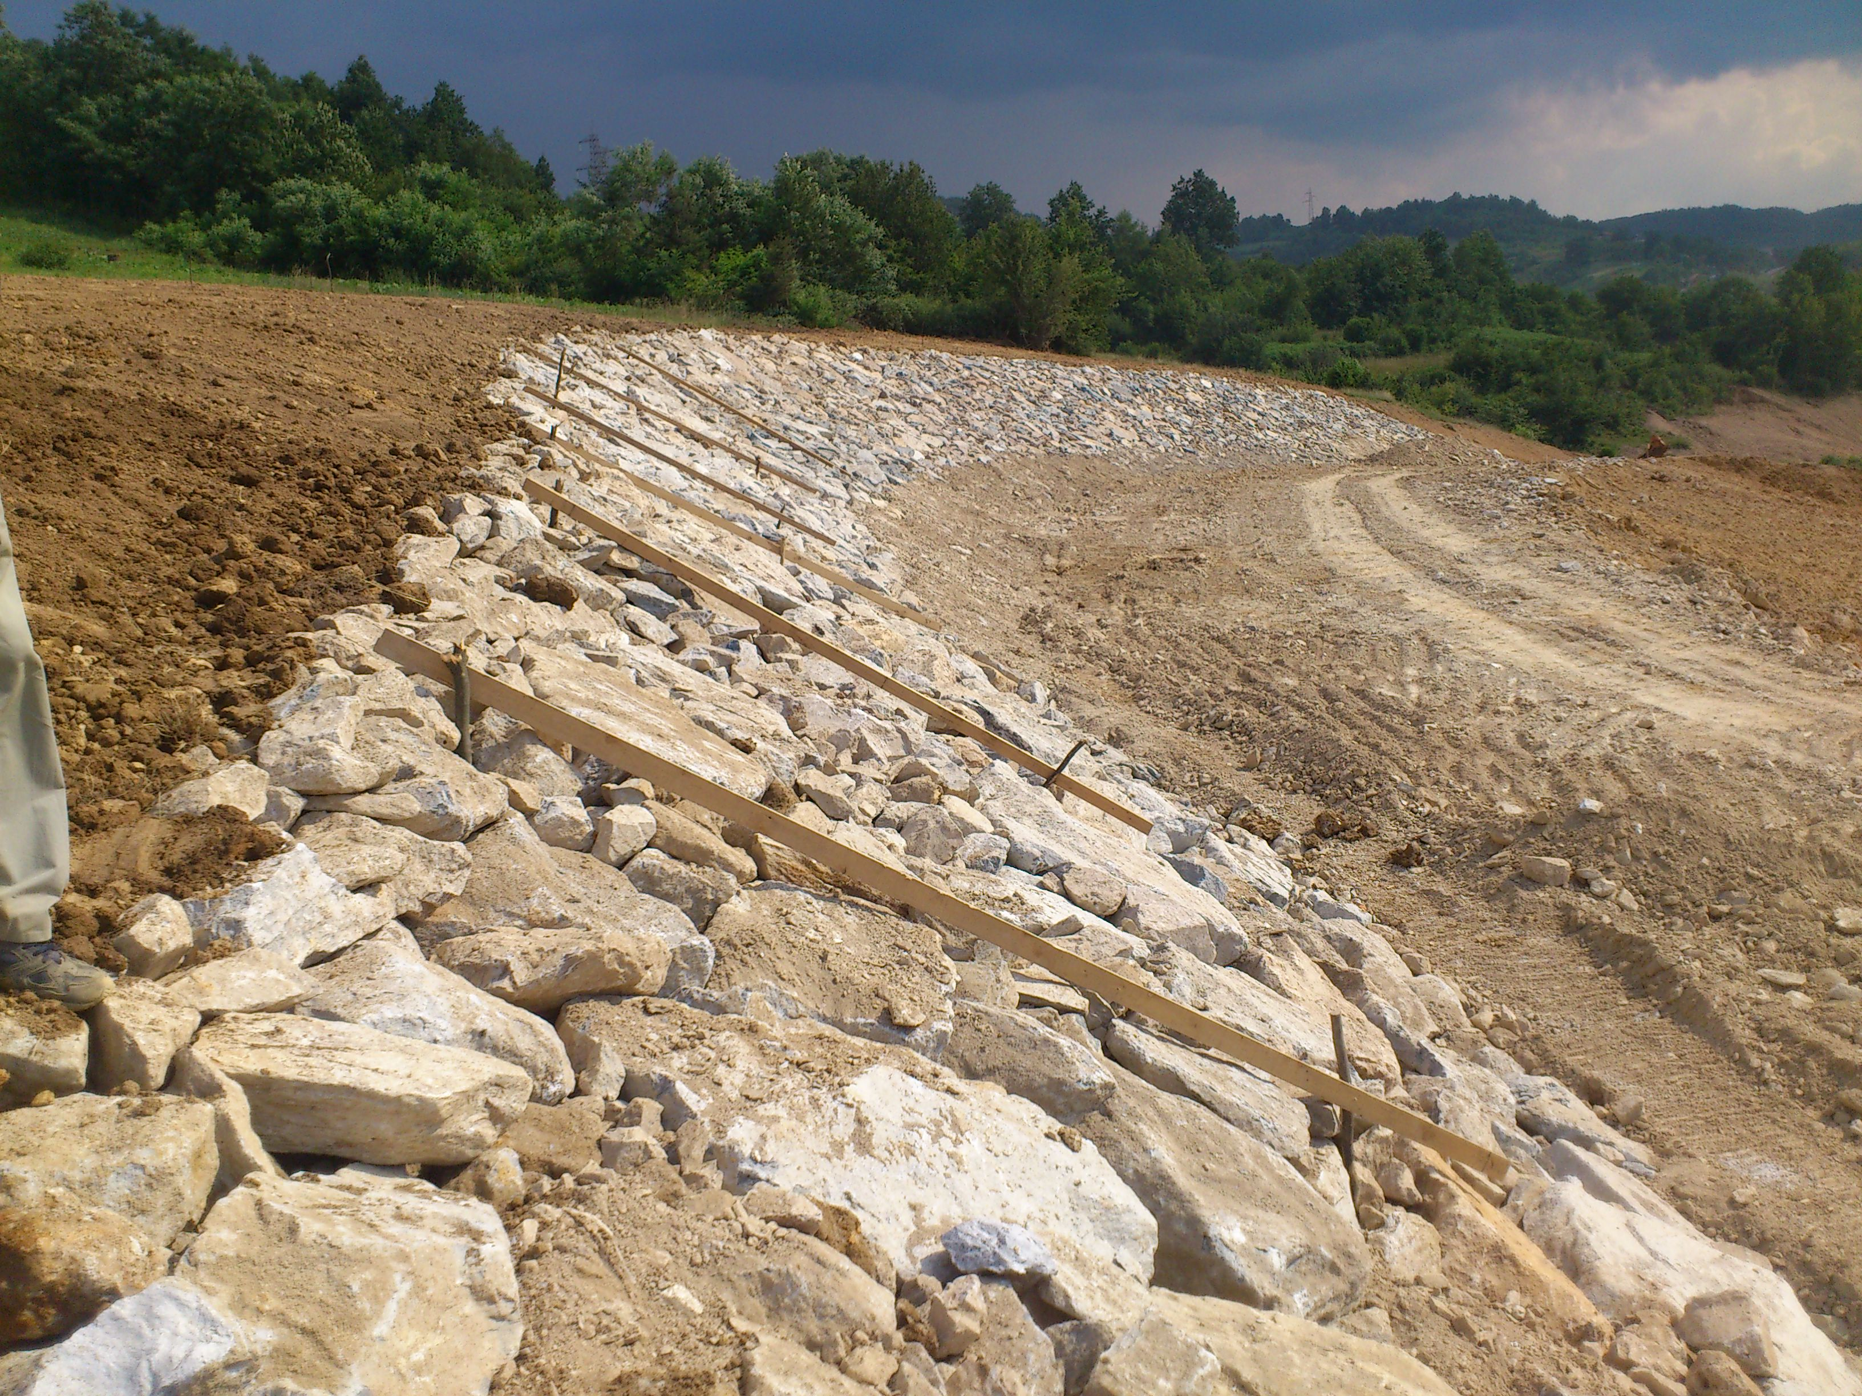
4. Learning outcomes
Understanding the Nature and Landslides mechanisms typical for Bosnia and Herzegovina.
Importance of investigation works, monitoring, and observational methods for prediction of slope failures.
Learning lessons from practical case studies (successfully applied measures and failures).
Understanding the principles of simplified and advanced numerical modeling techniques of geotechnical structures interacting with landslides.

Slide 5
5. Training and learning methods
Online lectures and discussions.
Individual research.
Case study.

